Slide 1
Web Chatting Application
PRESENTED BY
ANUP RIMAL &
BHUPENDRA THAPA CHHETRI

Slide 2
Table of Contents
Introduction
Problem Statement
Objective
Scope and Limitation
Methodology
Use Case
Database Schema Design
Process Modelling: DFD
Architecture Design
Tools Used
Gantt Chart
Conclusion
ScreenShort

Slide 3
Introduction
A web chatting application allows users to communicate in real time over the internet.
It enables instant messaging through a user-friendly interface, often using technologies like WebSocket for seamless updates

Slide 4
Problem Statement
Scalability Issues
Inconsistent User Experience
Security and Privacy Concerns

Slide 5
Objective
To offer a user-friendly interface that works smoothly across devices and browsers
To build a scalable architecture that can handle increasing user traffic
To implement robust security measures, including encryption and user authentication

Slide 6
Scope and Limitation
Scope of Web Chatting Application | Limitation of Web Chatting Application
Cross-Platform Compatibility | Internet Dependency
Expandable Features | Latency in Remote Regions
Real-Time Communication | Limited Offline Functionality

Slide 7
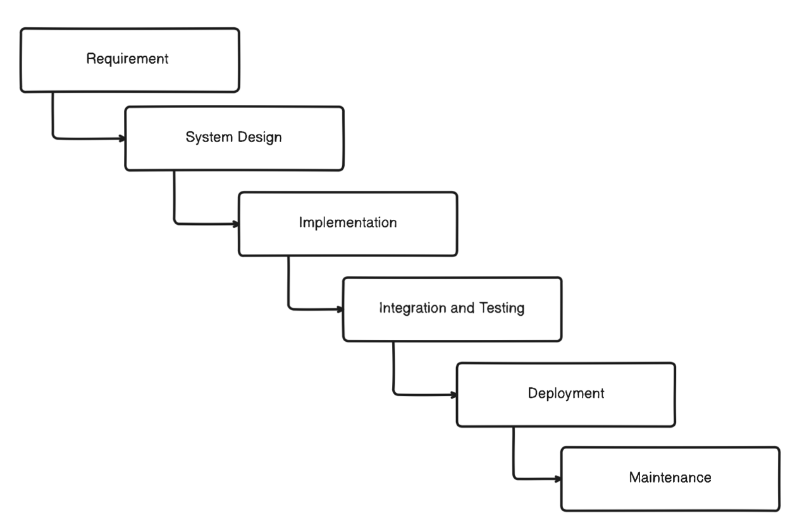
Methodology

Slide 8
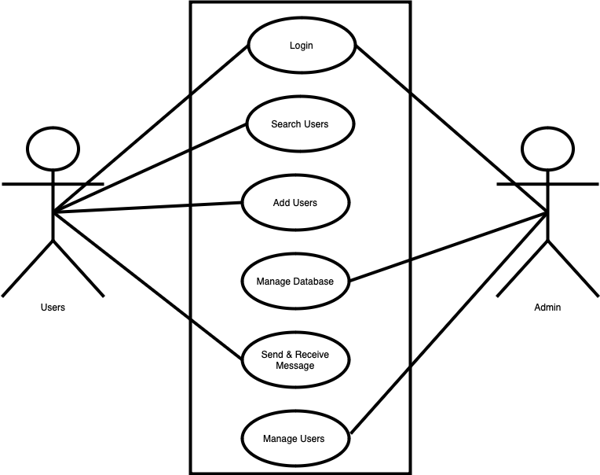
Use Case

Slide 9
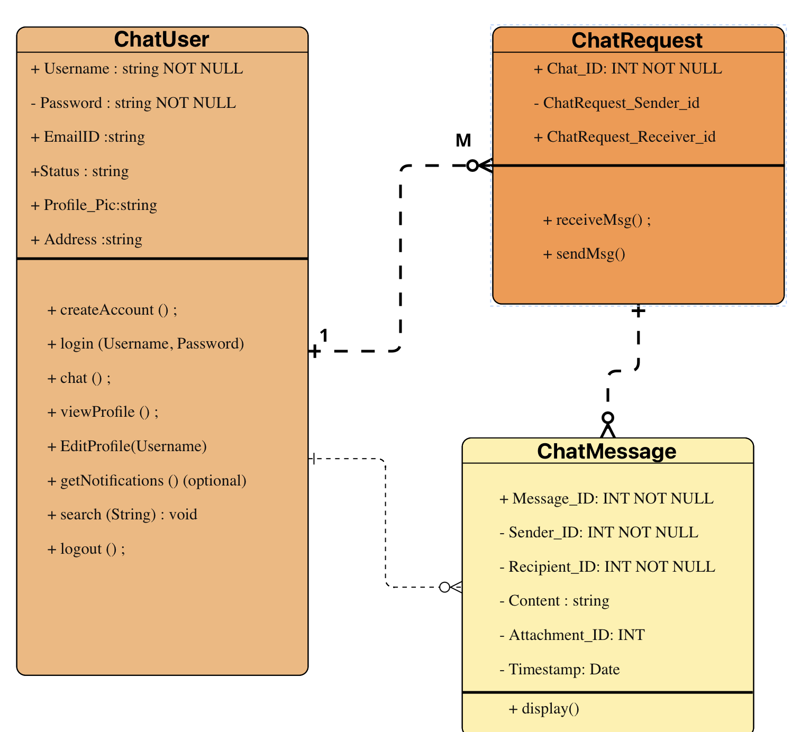
Database Schema Design

Slide 10
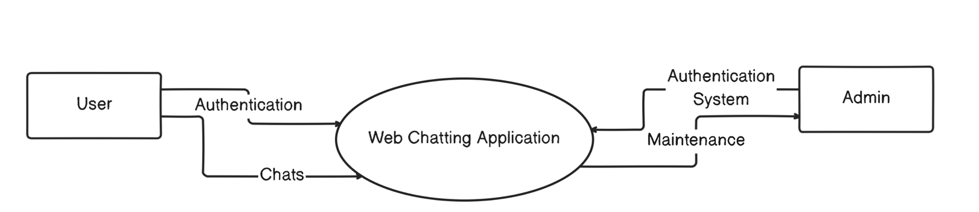
Process Modelling: DFD
Zero Level of DFD

Slide 11
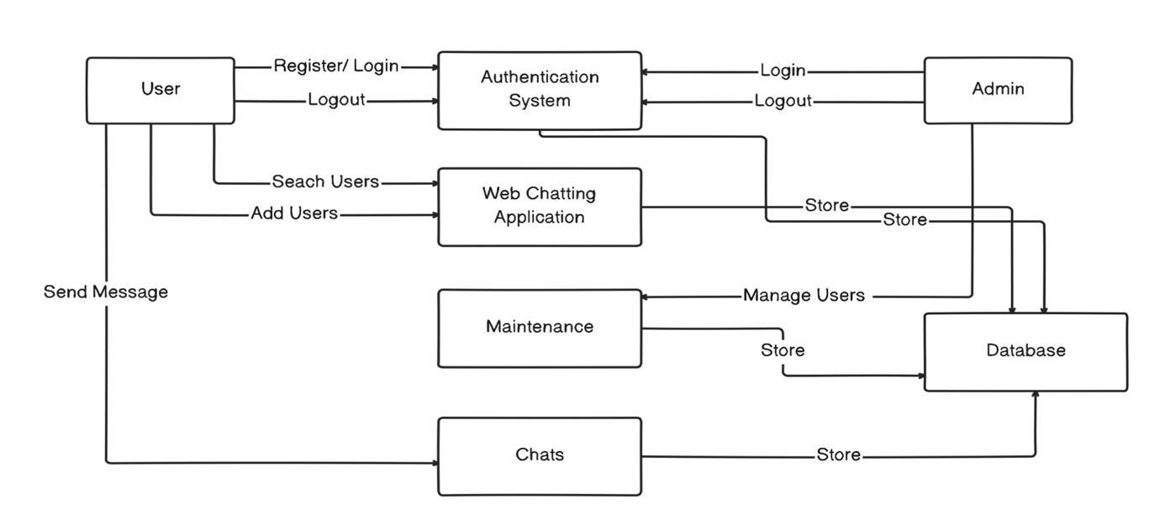
First Level of DFD

Slide 12
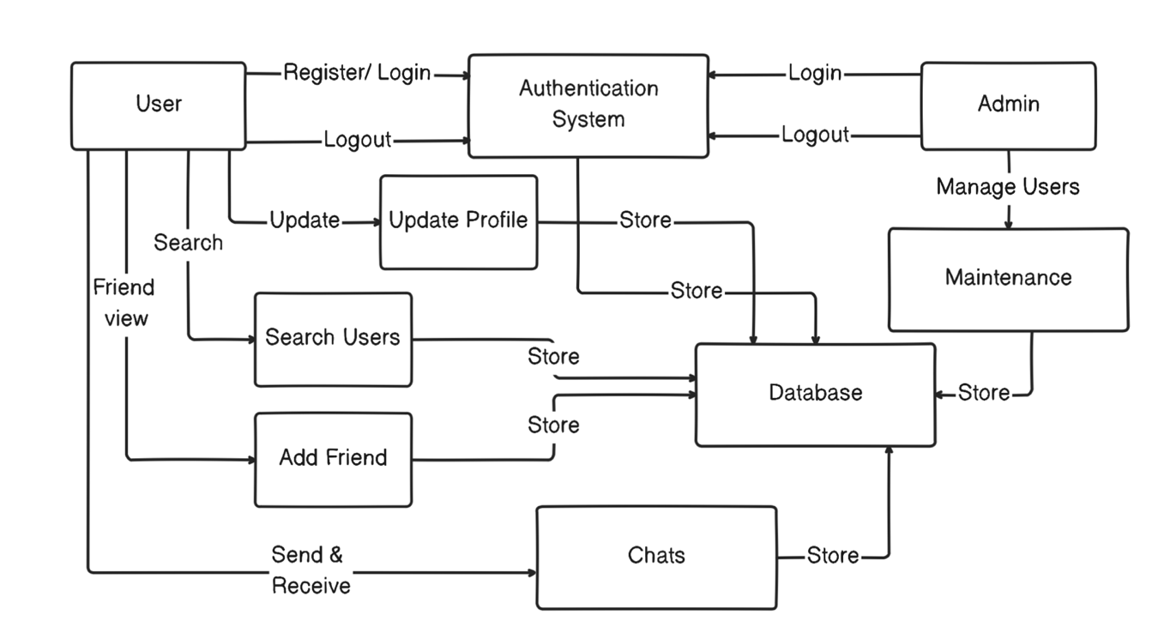
Second Level of DFD

Slide 13
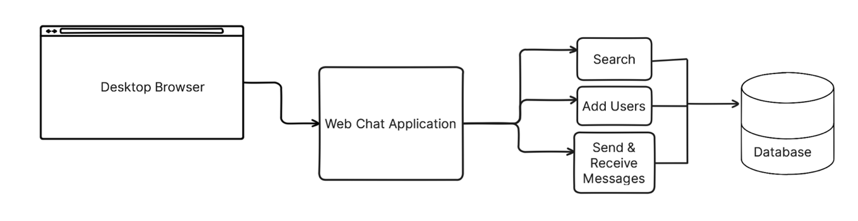
Architectural Design

Slide 14
Tools Used
Frontend | HTML, CSS, JavaScript
Backend | Node.js, Express.js
Database | MongoDB (NoSQL database)

Slide 15
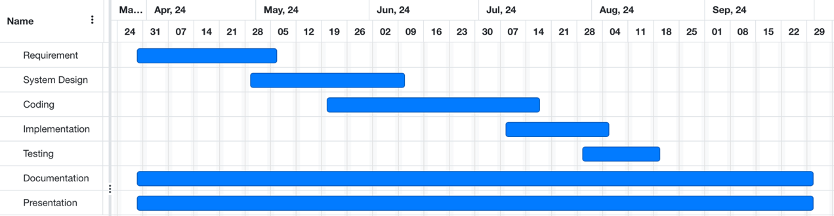
Gantt Chart

Slide 16
Conclusion
The web chatting application has changed how people communicate by making it easy to chat from home or on the go.
Web chatting application offers a reliable and secure communication

Slide 17
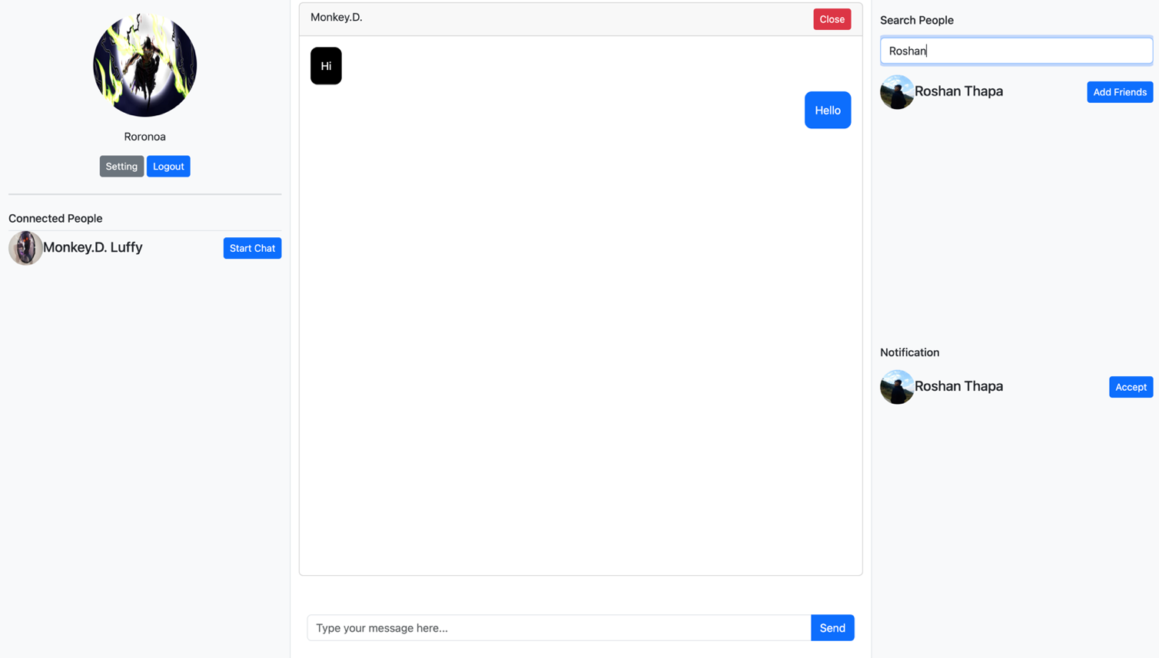
Screenshot
Index Page

Slide 18
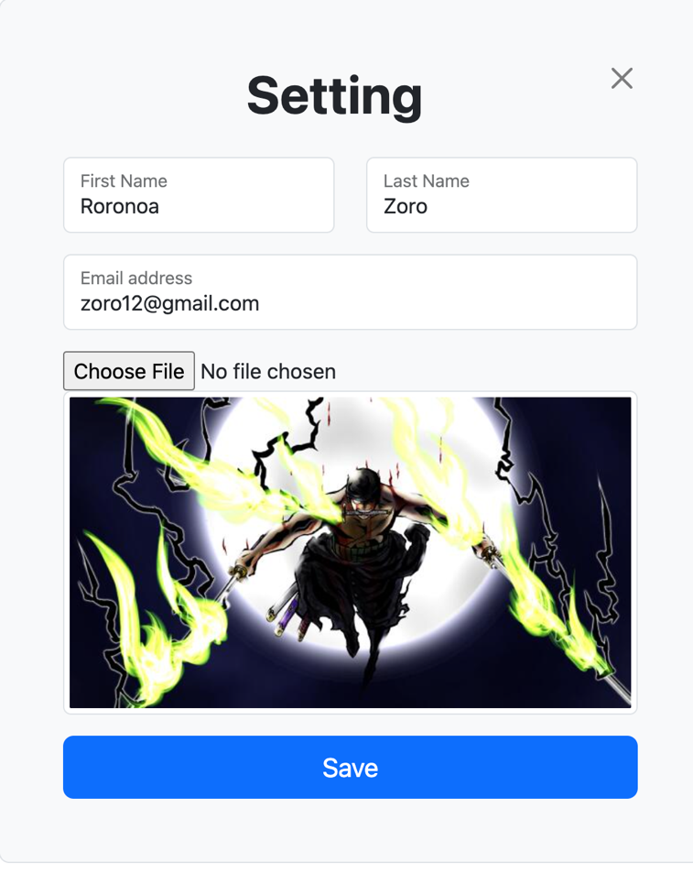
Profile Upload

Slide 19
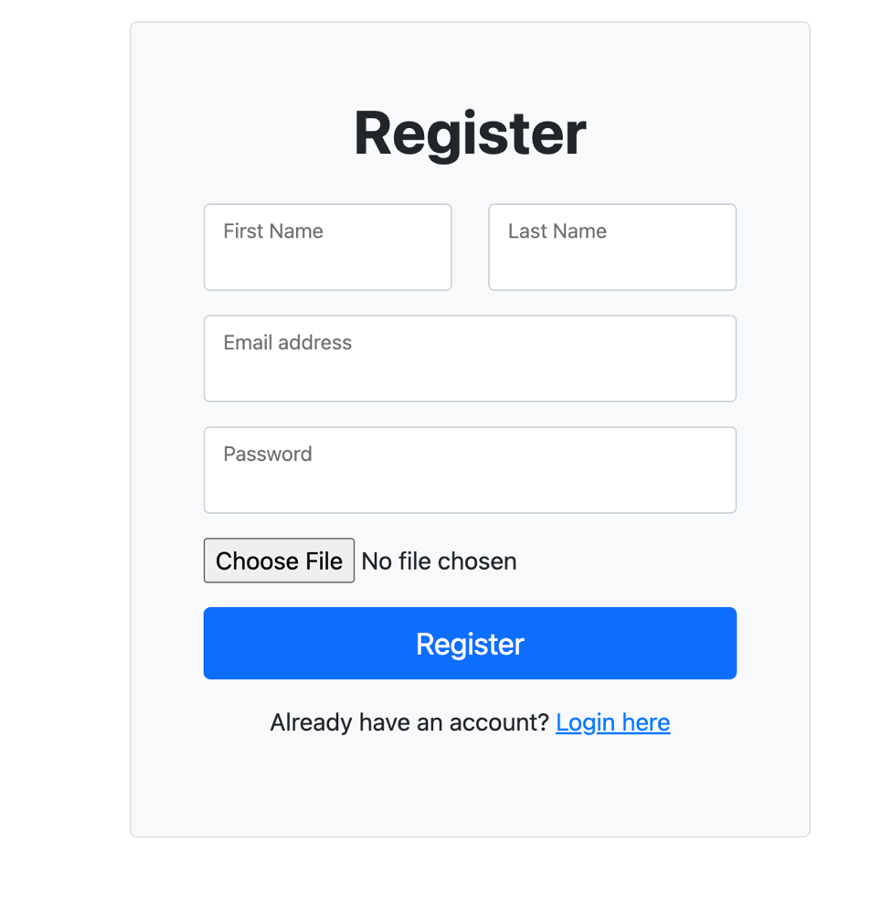
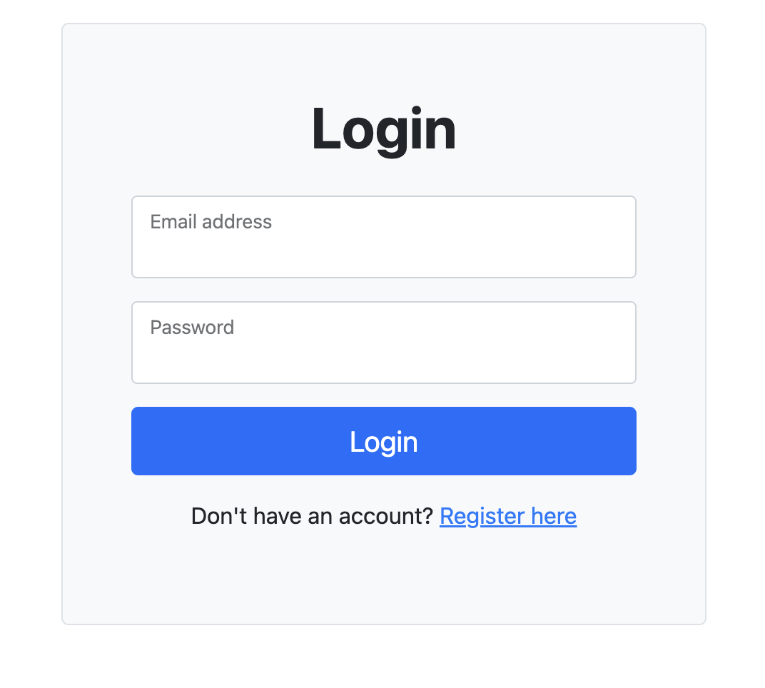
Registe and Login page

Slide 20
Thank You

